Slide 1

Hospital Management System
A Project Created by
Damriya Jay
(24124015)
Harendra Singh
(24124020)
A project by
Damriya Jay Harsingbhai
Harendra Pal Singh
:Sunshine Hospital

Slide 2
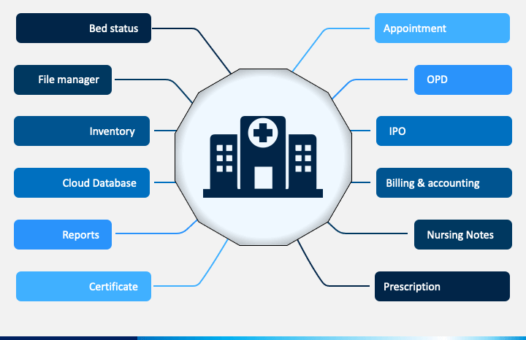
Aim of the Project

Slide 3
Language used For Front End and Back End
Front-End=(Java Swing) created by Harendra Singh
Back-End=(Java) created by Damriya Jay
Layout and Other menu panel created by Harendra Singh.
Search Option for the patient and medicine and other medical staff or room , case etc created by Damriya Jay.
Edit and Add System created by Damriya Jay and Harendra Singh.

Slide 4
Features Included in our Project
Appointment feature which allow the patient to make an appointment with the available doctor of the Sunshine Hospital.
Doctor Data Sheet which include the availability timing and the speciality of the doctor .
Inventory System include the medicine available in the Pharmacy or drug store of the Sunshine Hospital.
Lab Order which include the testing features like blood sugar test , blood checking test etc .
OPN feature include the status of the patient whether it is complete or it is pending.
Billing system include the medical fees and other fees to be paid by the patient that is admitted .It includes the record of the hospital payment system.
Patient Data sheet include the diseases ,age ,gender and other personal detail of the patient.
Facility features include the medical facility like MRI and X-ray etc and other regular facility of the hospital.
IPD-(IN PATIENT DEPARTMENT)—Status of the patient who needed to stay to the hospital due to there medical condition.

